Slide 1

MAHATMA GANDHI INSTITUTE OF TECHNOLOGY(A)
DEPARTMENT OF INFORMATION TECHNOLOGY
AN INSDUSTRY ORIENTED MINI PROJECT(IT653PC)
ON
REAL-TIME FACIAL EMOTION DETECTION WITH SMART FEEDBACK
BY
B.SNEHITHA-22261A1211
K.PRADEEP REDDY-22261A1230
BATCH ID:IT-25-18
IOMP Supervisor
Mrs.U.Chaitanya
Assistant Professor
Internal Supervisor
Mr.B.Tulasi Dasu
Assistant Professor

Slide 2
CONTENTS
ABSTRACT
INTRODUCTION
EXISTING SYSTEM
LITERATURE SURVERY
PROBLEM STATEMENT
REQUIREMENTS
PROPOSED SYSTEM
OBJECTIVES
MODULES DESCRIPTION
METHODOLOGIES
DESIGN ARCHITECTURE&UML DIAGRAMS
APPLICATIONS
TESTCASES
RESULTS
CONCLUSION
FUTURE ENHANCEMENT
REFERENCES

Slide 3
ABSTRACT
This project detects human emotions in real-time using facial expressions.
A pre trained deep learning model is used.
The system provides the voice feedback based on the facial expressions.
A real time emotion graph is used to visualize the current emotion
It engages the pickup lines and gives the desktop notifications based on the given emotion.
It helps machines understand human emotions and improve human-computer interactions.
Useful in mental health monitoring, AI assistants, customer service, and security.
Uses OpenCV for face detection and DeepFace for emotion recognition.

Slide 4
INTRODUCTION
Emotion detection is an important area in artificial intelligence that helps machines understand human feelings.
The system uses computer vision and deep learning models to process real-time data from cameras .
Convolutional Neural Networks (CNNs) are utilized to detect and classify facial expressions, ensuring accurate and fast emotion recognition.
Real-time processing ensures fast and accurate emotion recognition, improving human-computer interaction.
The DeepFace framework is used for extracting features from facial expressions and classifying the emotions based on those features.
Haar Cascade Classifier (OpenCV) is used for face detection.

Slide 5
EXISTING SYSTEM
Most existing emotion recognition systems rely on manual annotation or traditional machine learning models that require handcrafted features.
These methods lack real-time processing capabilities and are often limited to basic emotions like happy, sad, and angry.
Systems using rule based or statistical approaches have low accurary when dealing with variations in lighting,facial occlusions and different expressions.
Many applications are limited to static images and making them unsuitable for real time video analysis.

Slide 6
LITERATURE SURVEY
S.NO | AUTHOR NAMES,YEAR OF PUBLICATION | JOURNAL OR CONFERENCE NAME AND PUBLISHER NAME | METHODOLOGY/ ALGORITHM / TECHNIQUES USED | MERITS | DEMERITS | RESEARCH GAPS
1 | Barhoumi, C., BenAyed, Y. (2025) | Artificial Intelligence Review 58 | Deep learning and data augmentation for real-time face emotion recognition | Enhances recognition performance, improves model robustness with augmented data | Increased computational requirements, potential overfitting issues | Needs more real-world testing for practical implementation
2 | M. Bhanupriya, N. Kirubakaran and P. Jegadeeshwari (2023) | International Conference on Data Science, Agents & Artificial Intelligence (ICDSAAI), Chennai, India | EmotionTracker: Real-time Facial Emotion Detection with OpenCV and DeepFace | Combines traditional image processing with deep learning for enhanced detection | Less effective for complex emotions, limited emotion categories | Expansion to a broader range of emotions and real-world scenarios needed
3 | T. Winyangkun, N. Vanitchanant, V. Chouvatut and B. Panyangam (2023) | 15th International Conference on Knowledge and Smart Technology (KST), Phuket, Thailand | Real-Time Detection and Classification of Facial Emotions | Accurate classification, lightweight model for real-time applications | Performance degrades in low-light conditions, high sensitivity to noise | Lacks multi-modal emotion recognition integration

Slide 7
S.NO | AUTHOR NAMES,YEAR OF PUBLICATION | JOURNAL OR CONFERENCE NAME AND PUBLISHER NAME | METHODOLOGY/ ALGORITHM / TECHNIQUES USED | MERITS | DEMERITS | RESEARCH GAPS
4 | M. Bhanupriya, P. Jegadeeshwari (2023) | International Conference on Data Science, Agents & Artificial Intelligence (ICDSAAI), Chennai, India | EmotionTracker: Real-time Facial Emotion Detection with OpenCV and DeepFace | Combines traditional image processing with deep learning for enhanced detection | Less effective for complex emotions, limited emotion categories | Expansion to a broader range of emotions and real-world scenarios needed
5 | M. A. Ozdemir, B. Elagoz, A. Alaybeyoglu, R. Sadighzadeh and A. Akan (2020) | 2020 Medical Technologies Congress (TIPTEKNO), Izmir, Turkey | CNN Architecture for facial emotion recognition | High accuracy in emotion detection, efficient feature extraction | Requires large datasets for training, computationally expensive | Limited generalizability to diverse datasets, lack of real-time optimization

Slide 8
PROBLEM STATEMENT
Many existing emotion recognition systems do not support real-time emotion detection using live webcam input.
Interactive feedback mechanisms like voice responses and notifications are often missing in traditional solutions.
Detection accuracy drops significantly under varying lighting conditions, facial occlusions, and head movements.
Most systems lack the capability to monitor and analyze emotional trends over time.
Personalized responses, such as context-aware messages or comforting voice outputs, are not incorporated to improve user engagement.
There is no provision for delivering a final mood summary to help users reflect on their emotional state during the session.

Slide 9
REQUIREMENTS
SOFTWARE:
Operating System: Windows 10/11
Programming Language: Python 3. 9
Libraries :OpenCV (for face detection)
TensorFlow/Keras (for deep learning models)
NumPy & Pandas (for data handling)
Pyttsx3(Text-to-speech conversion)
Plyer(used for providing messages)
Collections(tracks emotions)
IDE/Code Editor: VS Code
HARDWARE:
Processor: Intel i5/i7
Camera: HD Webcam (for facial expression analysis)

Slide 10
PROPOSED SYSTEM
A deep learning-based model capable of recognizing emotions in real-time.
Processes live images and classifies emotions instantly and give the voice feedback,pop up messages.
Uses Convolutional Neural Networks(CNNs) and transfer learning to improve accuracy
Integrates OpenCV and DeepFace for facial detection and analysis.
Integrates plyer for pop up message notifications and also matplotlib for live emotion graph.
The system is optimized for high-speed performance with low latency,making it suitable for the real world applications.

Slide 11
OBJECTIVES
To detect human facial emotions in real time using webcam video feed
To classify facial expressions into emotions like Angry,Neutral,Happy,Sad etcc using a pre trained CNN model
To provide a voice based suggestions using pyttsx3 library based on the detected emotion.
To display desktop notifications with personalized pickup lines related to the detected emotion
To track and visualize the recent emotion pattern through a live updating bargraph.
To notify the user through voice output if no face is detected in the frame.
To notify the user overall mood feedback based on the graph.

Slide 12
MODULES DESCRIPTION
Face detection Module-Detects human faces in real time using the webcam.
Preprocessing Module: It prepares the detected face for emotion classification.
Emotion Detection Module: It uses the loaded CNN model to predict emotions like angry , happy, sad, etcc
Voice Feedback Module: It provides the voice based responsed for the detected emotions.
Desktop Notification Module: It shows the emotion based desktop pop up notifications.
Emotion trend graph Module: Displays a dynamic bar graph of recently detected emotions.

Slide 13
METHODOLOGIES
Capture input image/video frame.
Apply OpenCV for face detection.
Feed the processed image into the CNN model.
Predict the emotion label.
Display the detected emotion in real-time.
Visualize emotion trends in a graph
Handles the absence of face
Gives the overall feedback based on the graph

Slide 14
DESIGN ARCHITECTURE
Input Layer
Preprocessing Layer
CNN Model
Response &Interaction Module
Emotion analysis
Real time emotion graph and output

Slide 15
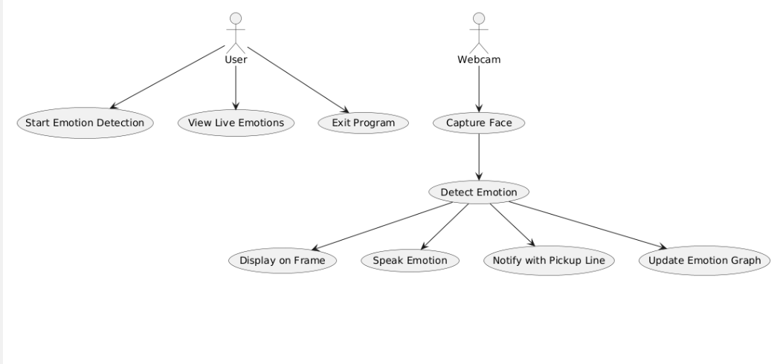
UML DIAGRAMS
USE CASE DIAGRAM

Slide 16
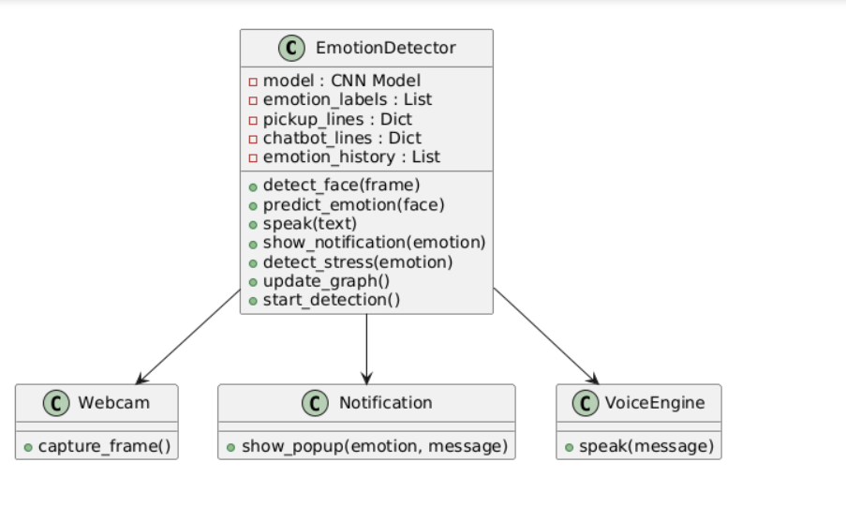
CLASS DIAGRAM

Slide 17
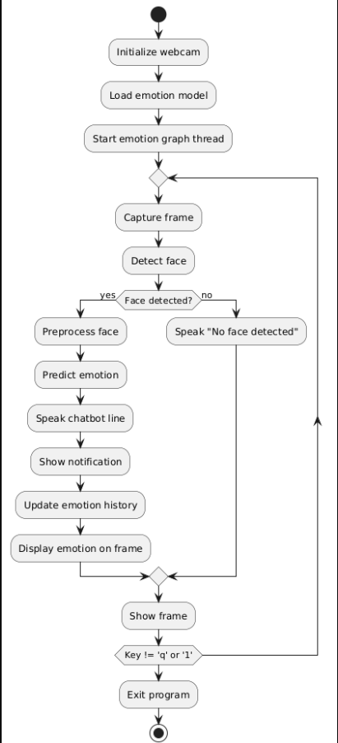
ACTIVITY DIAGRAM

Slide 18
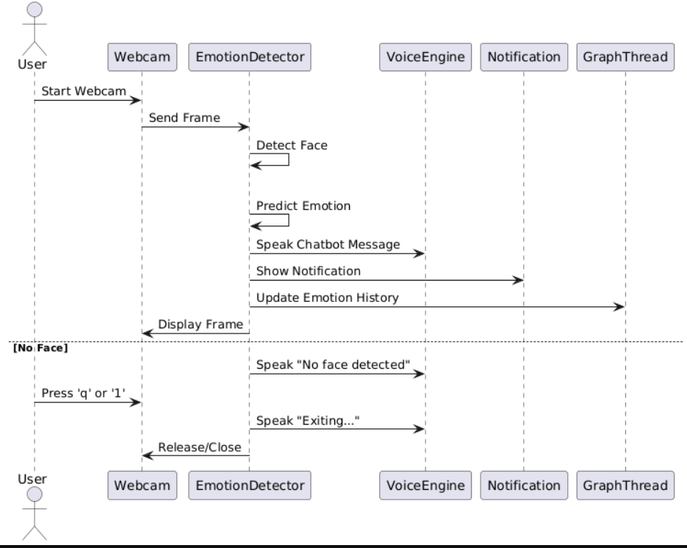
SEQUENCE DIAGRAM

Slide 19
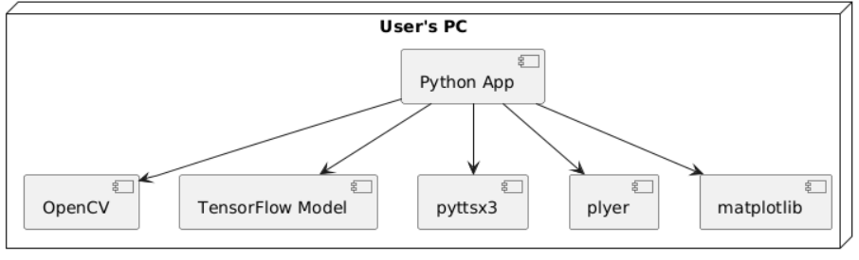
DEPLOYMENT DIAGRAM

Slide 20
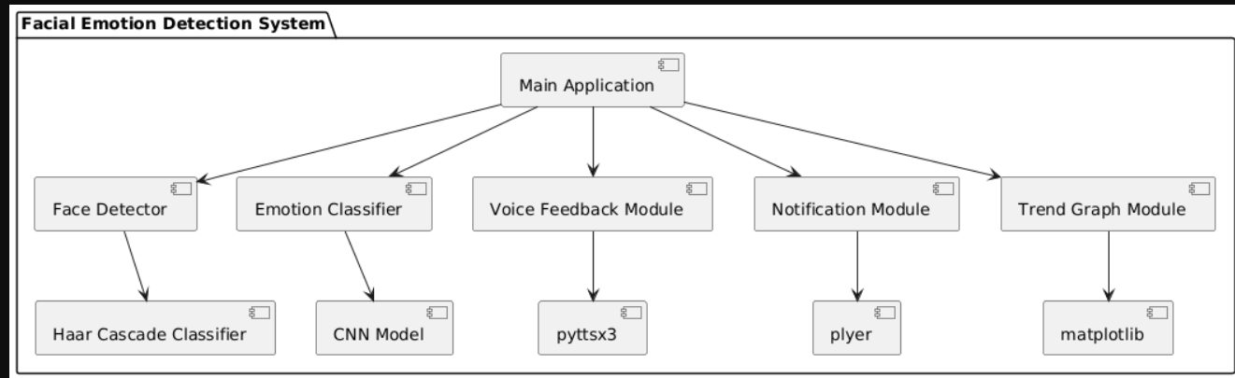
COMPONENT DIAGRAM

Slide 21
APPLICATIONS
Mental Health Monitoring – Helps therapists analyze emotional patterns.
Human-Computer Interaction (HCI) – Enhances AI assistants, chatbots, and VR applications.
Security & Surveillance – Detects unusual emotional states for crime prevention.
E-Learning Platforms-Monitors Student engagement in studies based on facial expressions

Slide 22
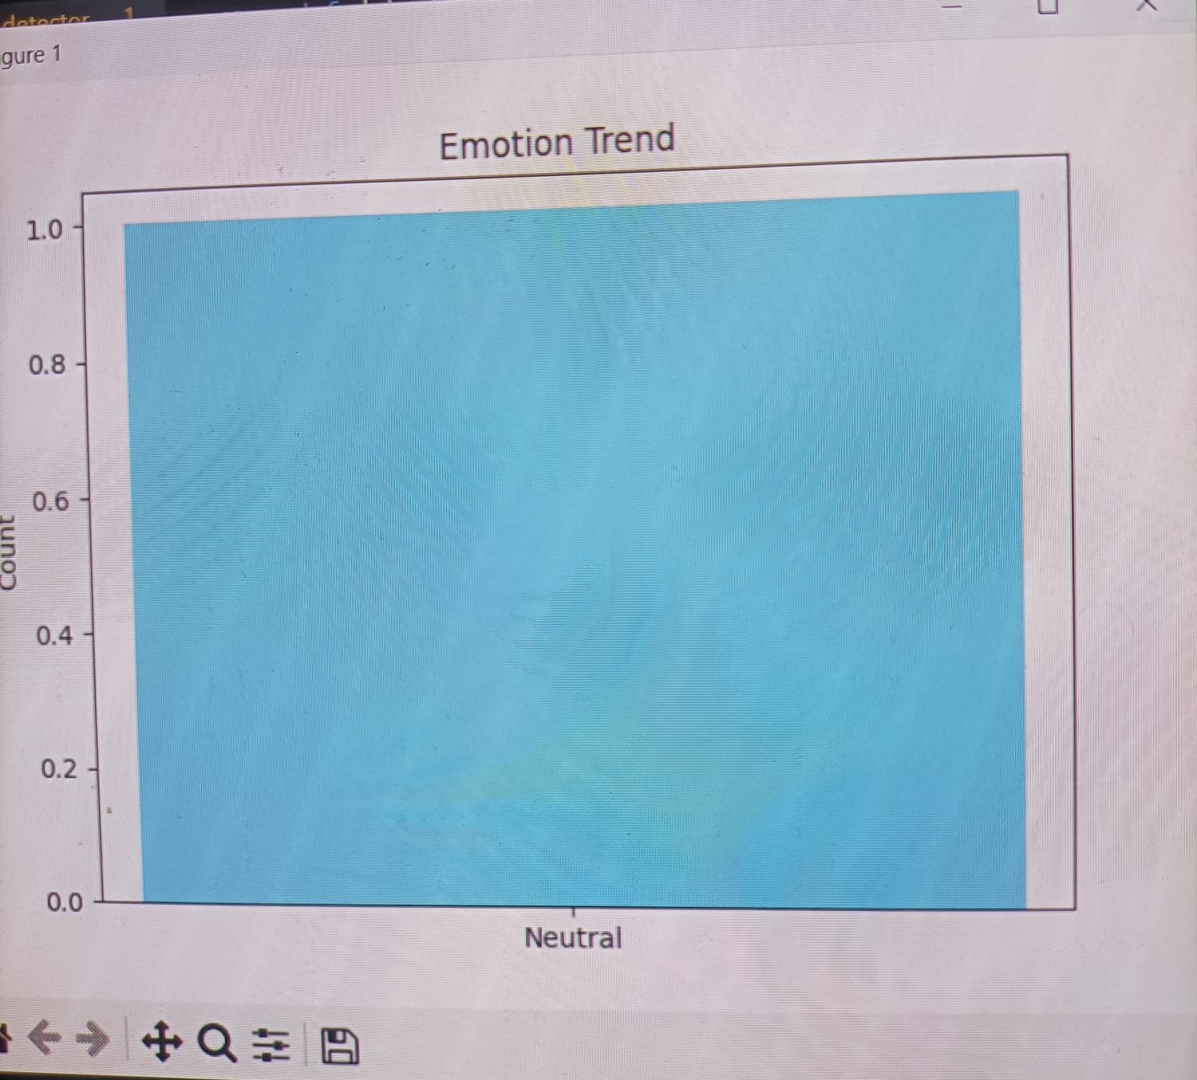
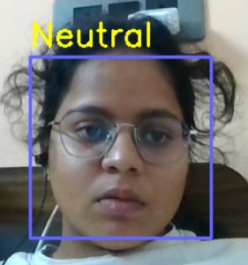
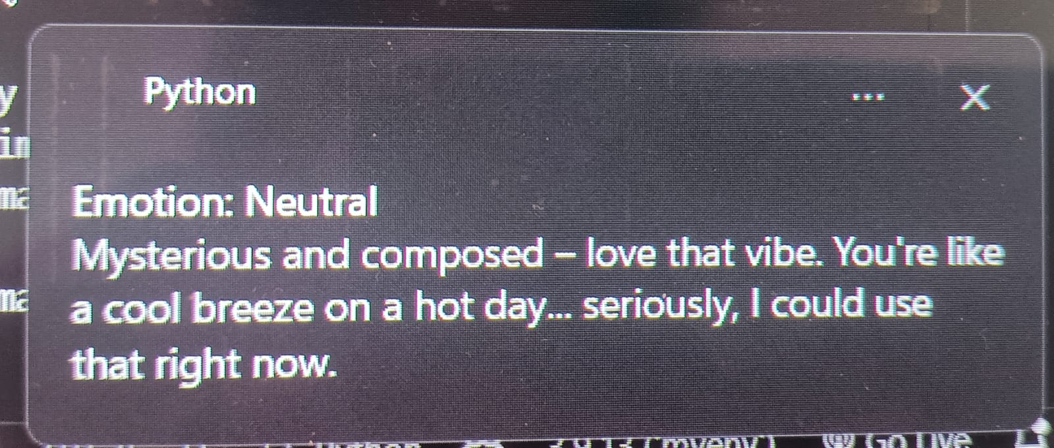
TEST CASES
Testcase-1:
When the person is in constant or neutral mood
Facial Bargraph: Pop-up Message:
Expression:

Slide 23
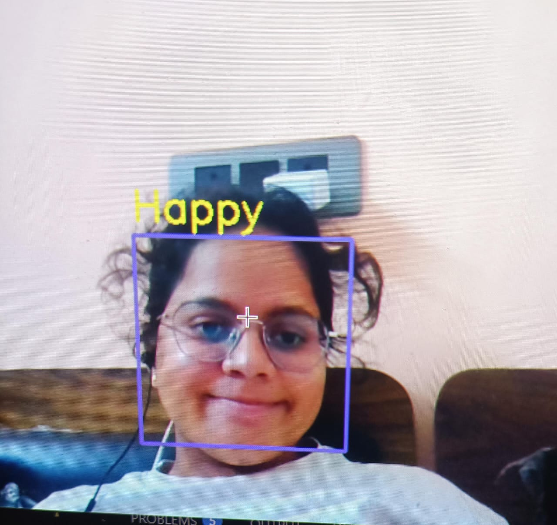
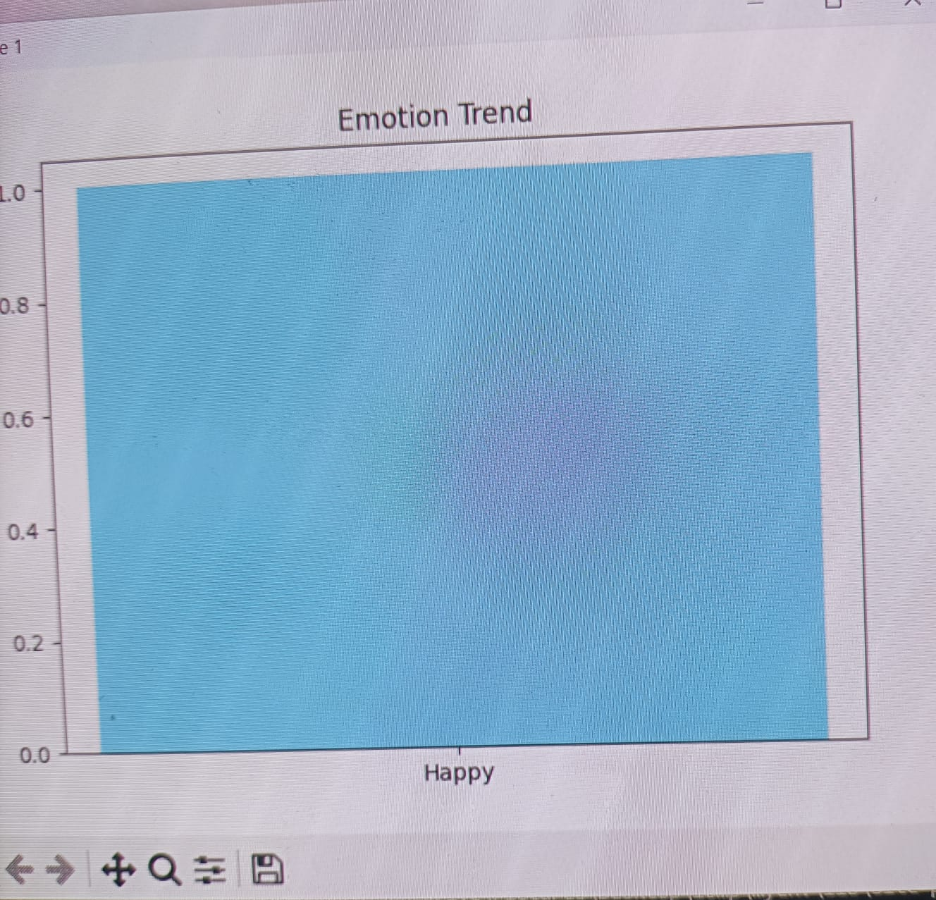
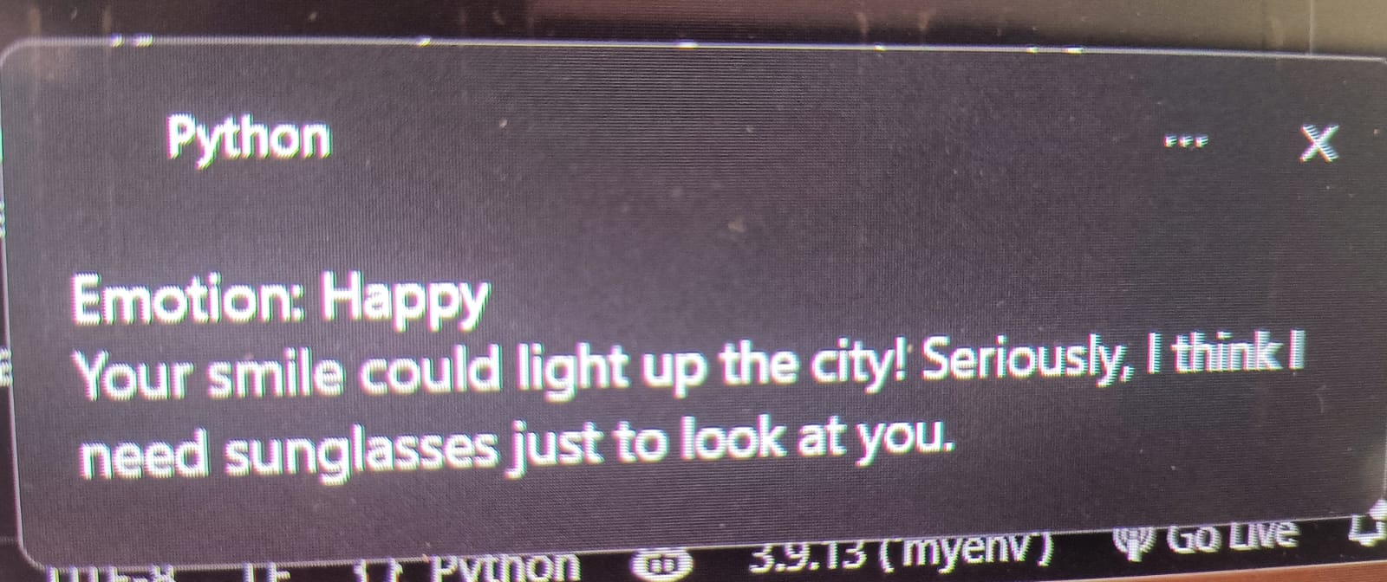
TestCase 2:
When the user is in happy mood:
Facial Bargraph: Pop-up message:
Expression:

Slide 24
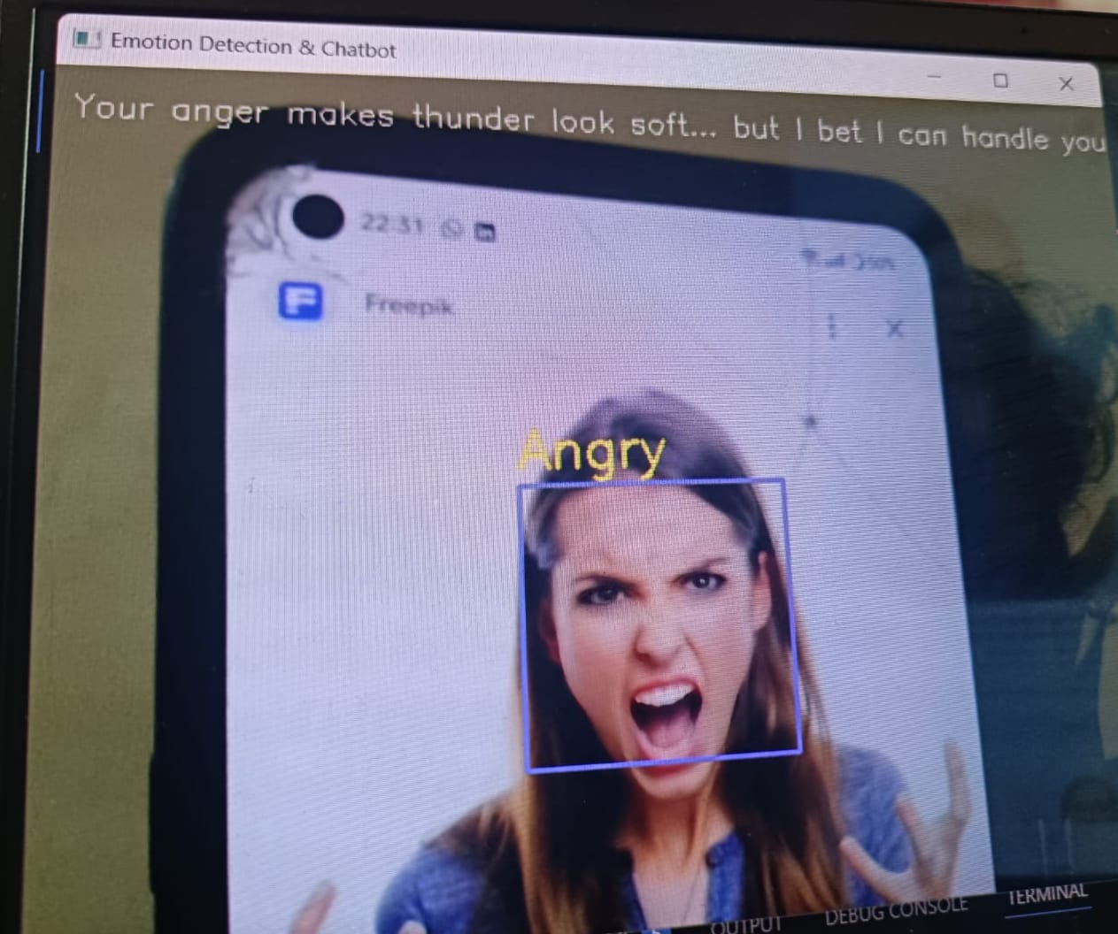
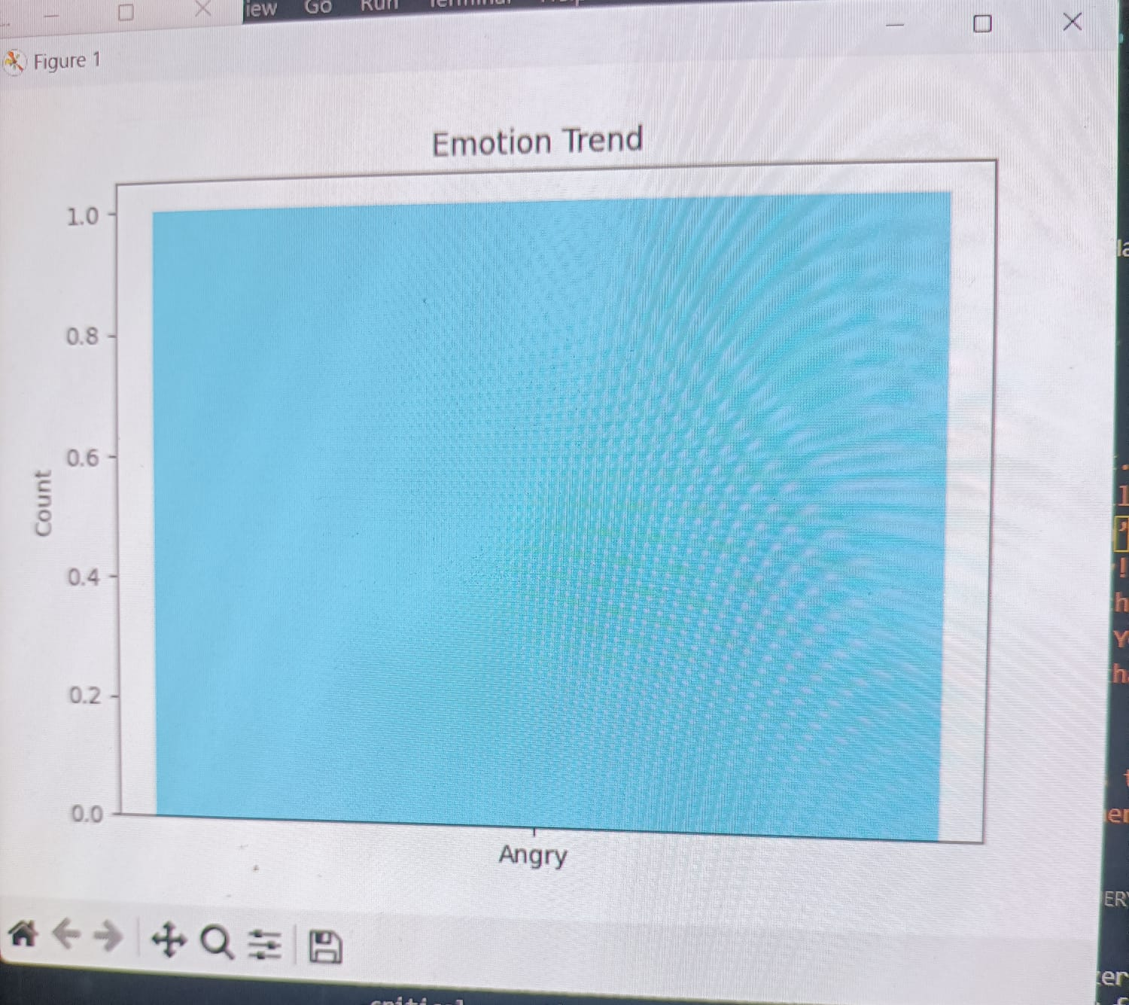
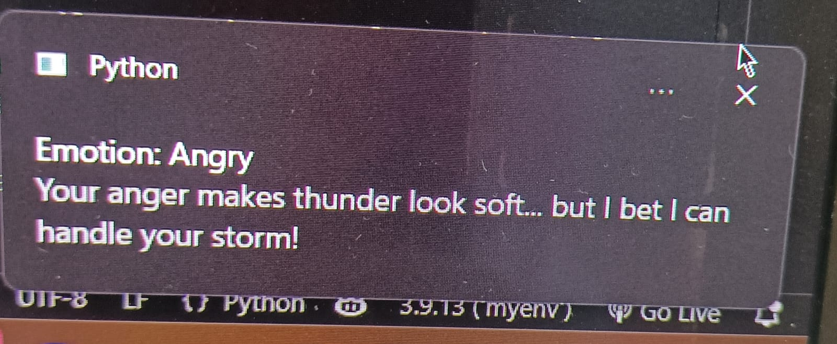
TestCase 3:
When the user is in angry mood:
Facial Bargraph: Pop-up message:
Expression:

Slide 25
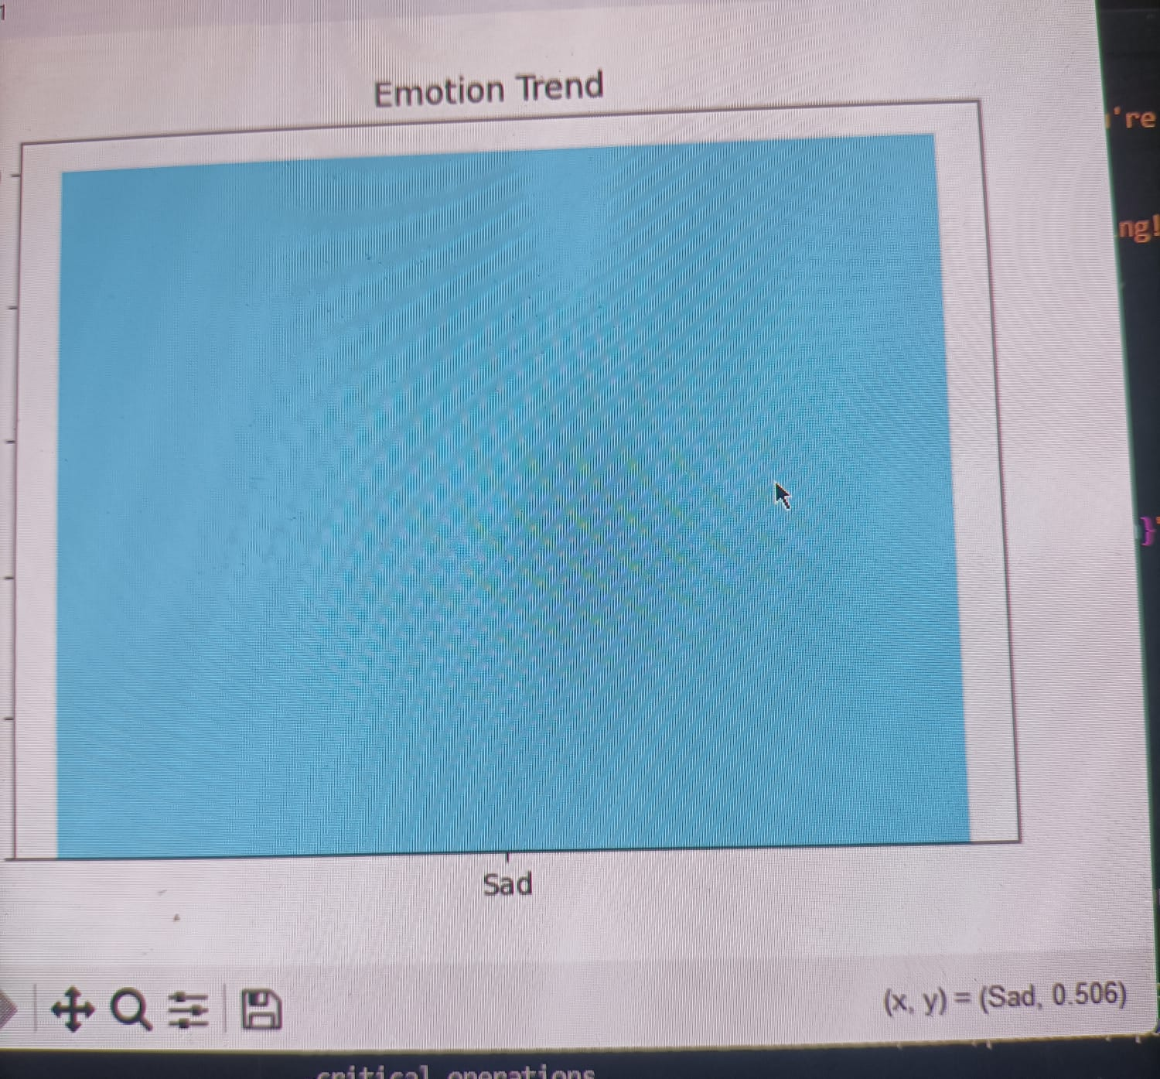
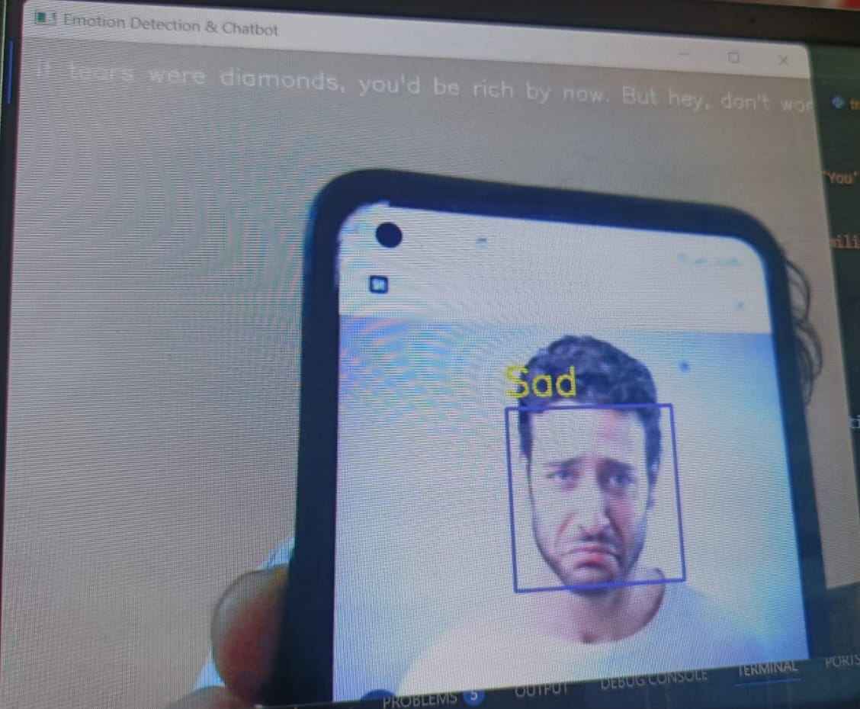
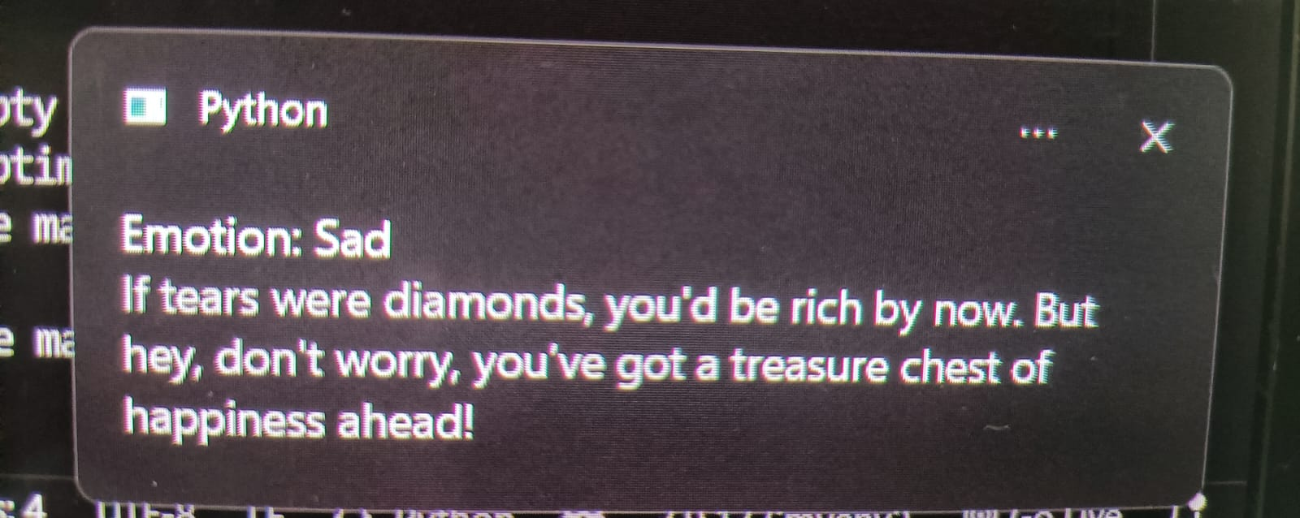
TestCase 4:
When the user is in sad mood:
Facial Bargraph: Pop-up message:
Expression:

Slide 26
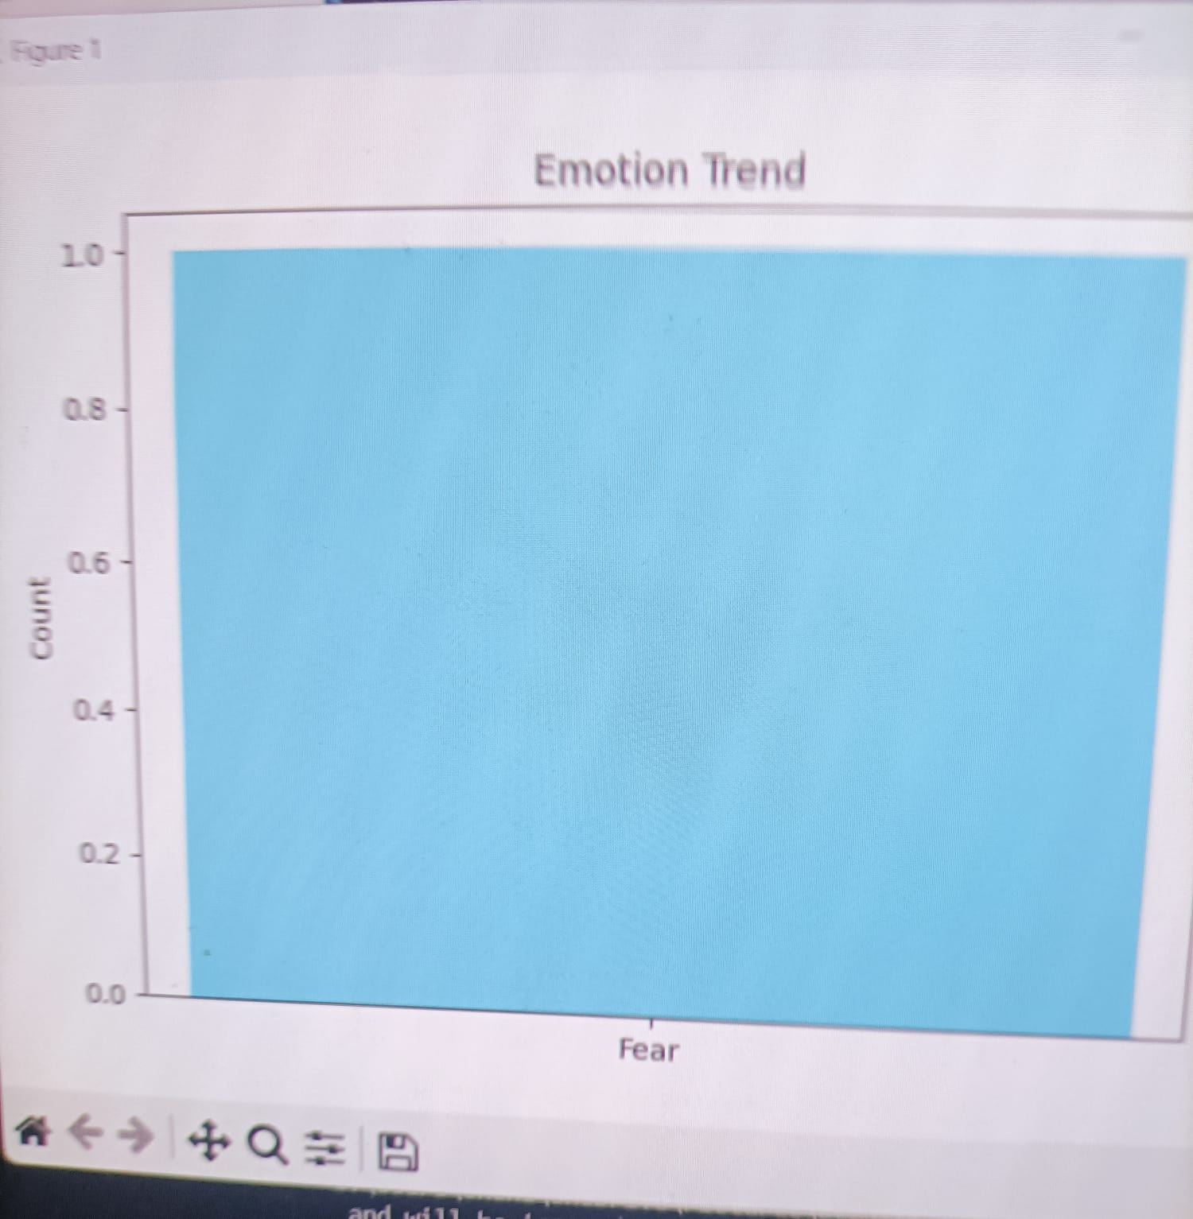
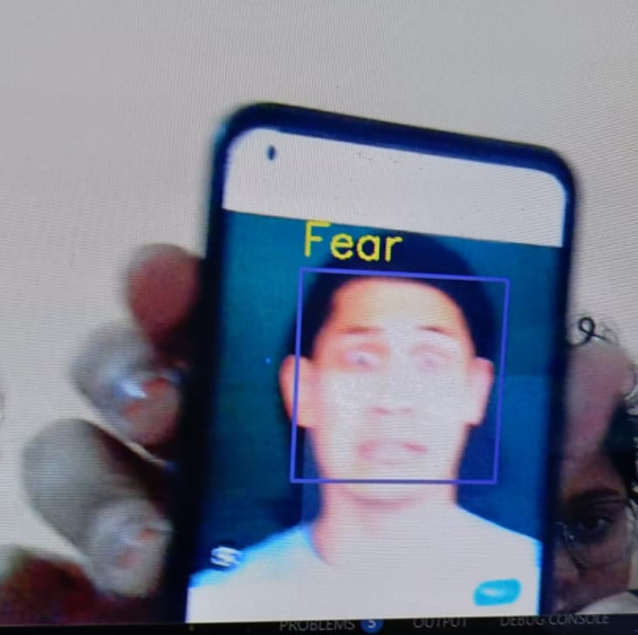
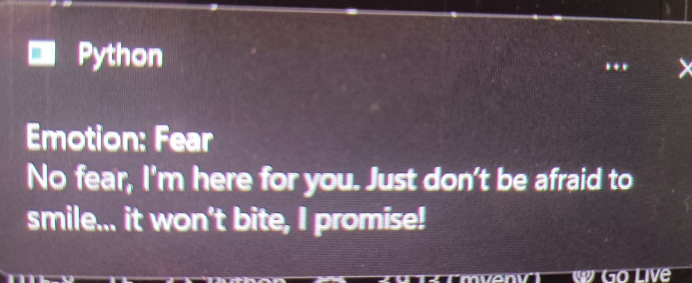
TestCase 5:
When the user is in fear mood:
Facial Bargraph: Pop-up message:
Expression:

Slide 27
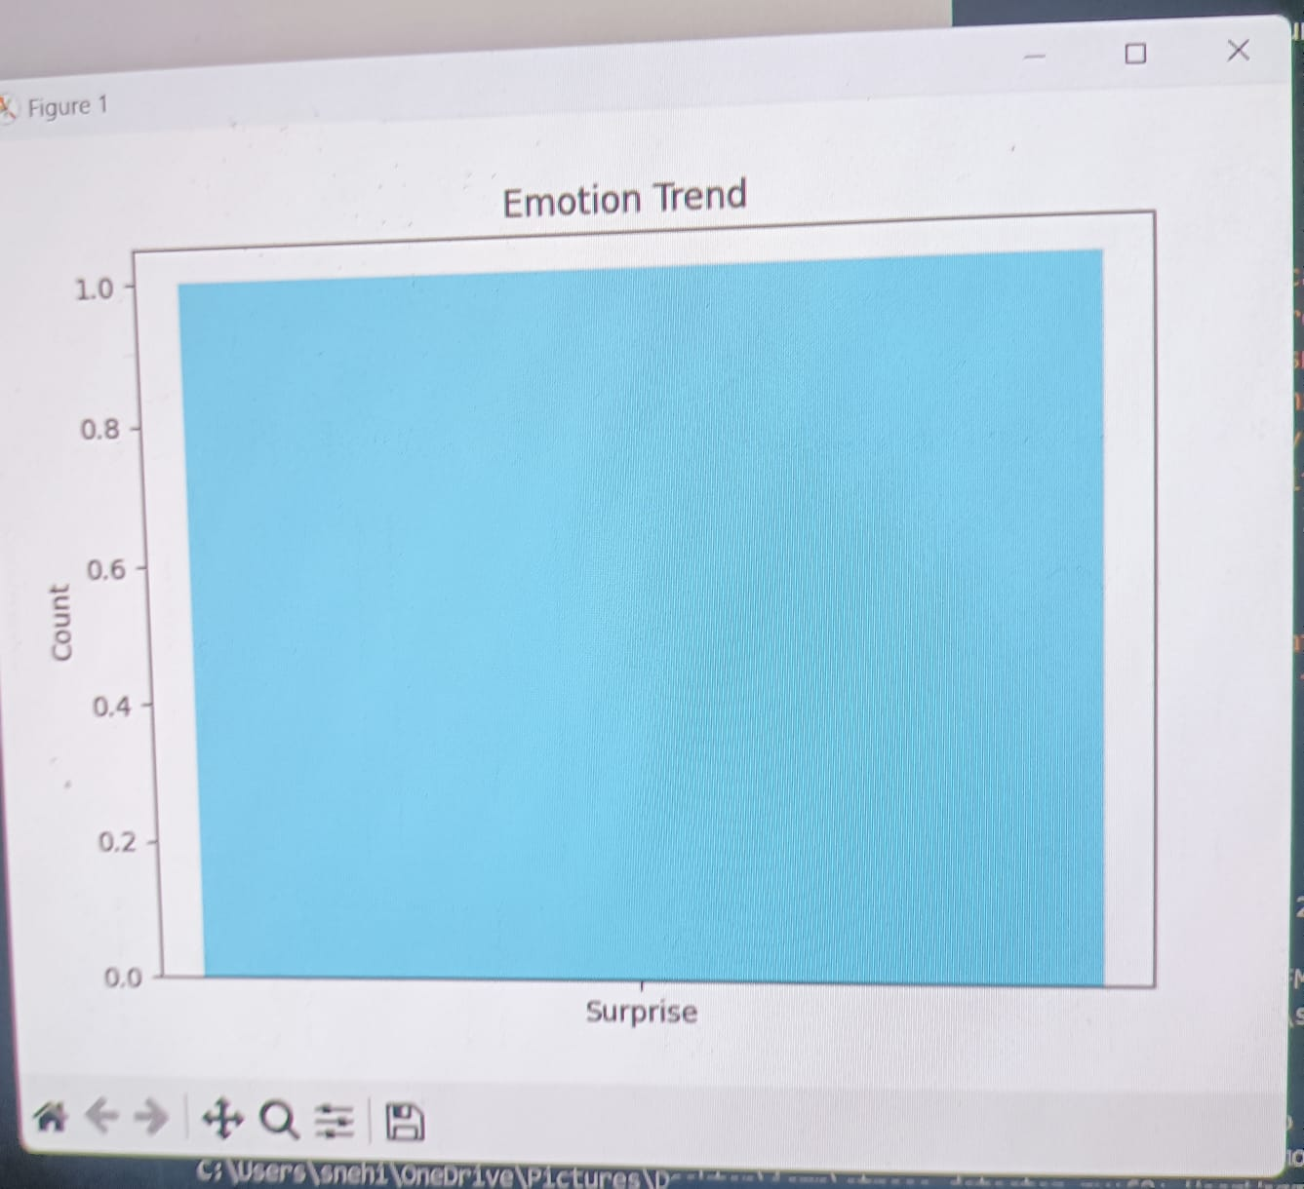
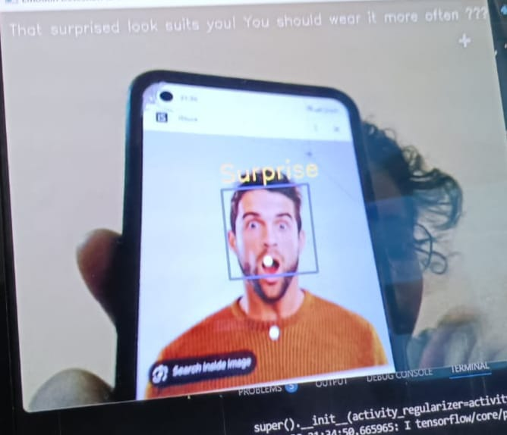
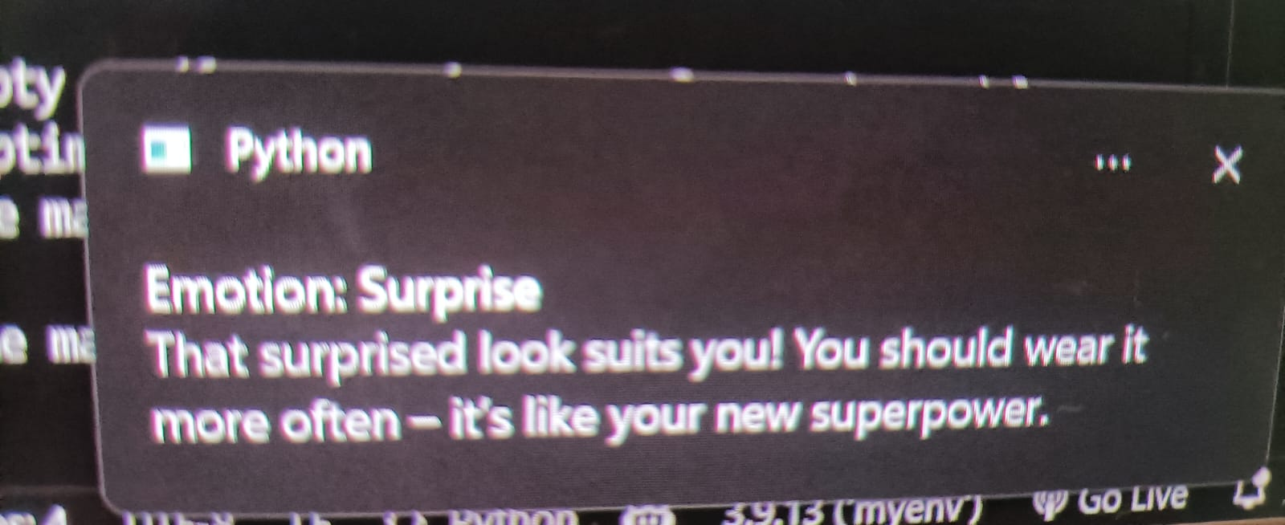
TestCase 6:
When the user is in surprise mood:
Facial Bargraph: Pop-up message:
Expression:

Slide 28
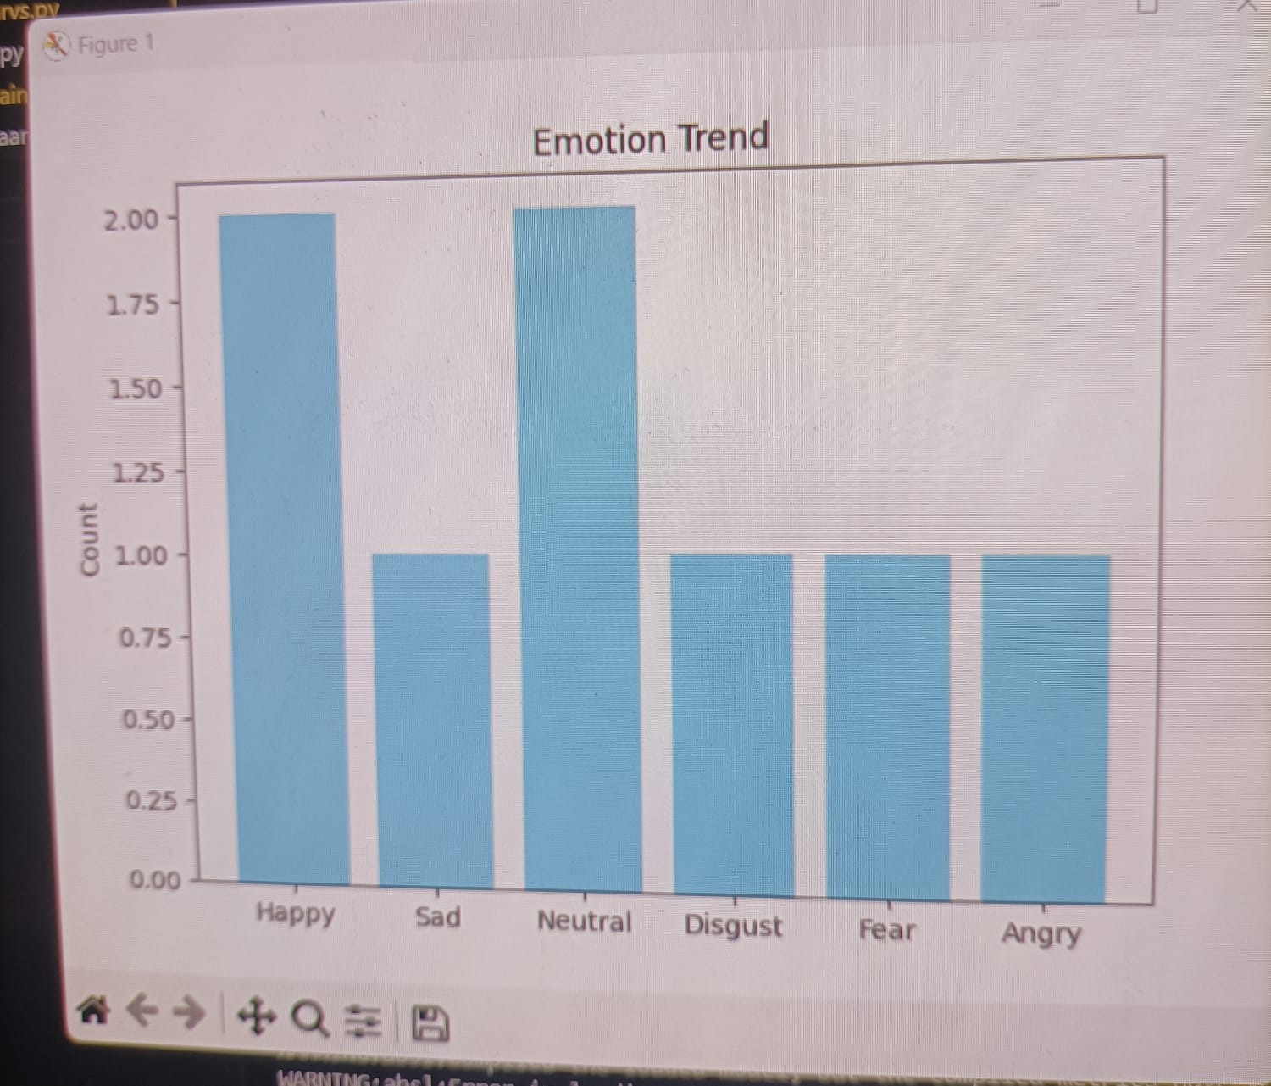
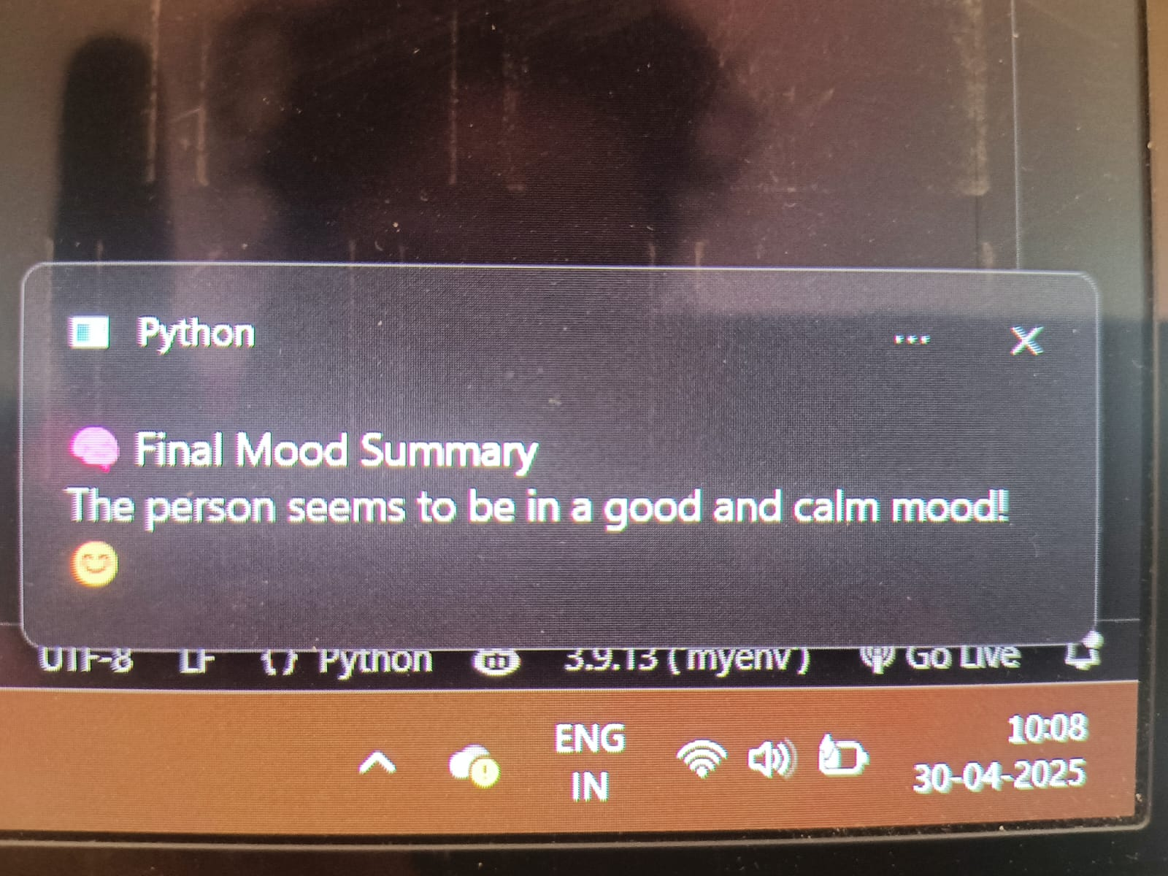
RESULTS
1.When the happy and neutral is greater than all the other emotions
Graph:
Pop up message:

Slide 29
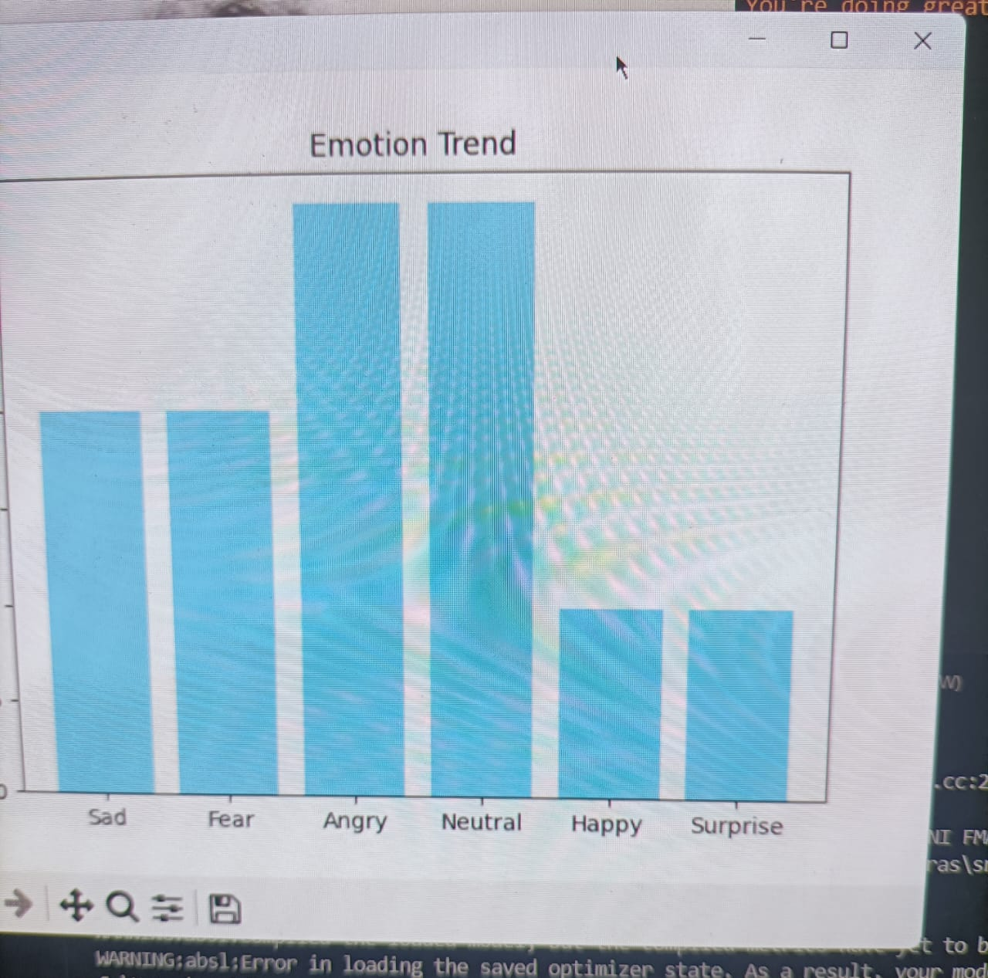
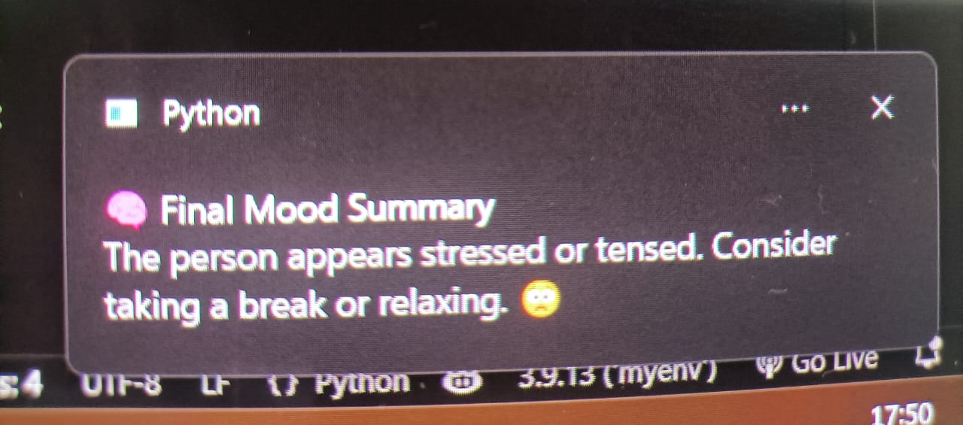
2.When the other emotions like sad,angry,etc.. dominates the happy emotion
Graph:
Pop-up message:

Slide 30
CONCLUSION
The system successfully detects the user facial expression and gives the smart feedback through live bargraph,voice feedback and pop up messages.
It enhances the user interaction with an exit GUI
It allows the real time graph visualization that users can track emotion trends overtime.
Final mood analysis summarizes emotional state at session end.
This tool is suitable for stress monitoring, mental wellness, and interactive applications.

Slide 31
FUTURE ENHANCEMET
Adding Emotion Intensity :
-Use model probabilities to show how strong each emotion is.
2.Emotion-Based Recommendations :
-Integrate music or video suggestions based on detected emotions.
3.Exit GUI Improvements:
-Add options like saving logs, graphs, or restarting the session.
4.Graph Saving Options :
-Automatically save emotion trend graphs at the end of the session.

Slide 32
REFERENCES
[1] M. A. Ozdemir, B. Elagoz, A. Alaybeyoglu, R. Sadighzadeh and A. Akan, "Real Time Emotion Recognition from Facial Expressions Using CNN Architecture," 2020 Medical Technologies Congress (TIPTEKNO),Izmir, Turkey, 2020, pp. 1-4, doi: 10.1109/TIPTEKNO.2020.8895215
[2] D. Joshi, A. Dhok, A. Khandelwal, S. Kulkarni and S. Mangrulkar, "Real Time Emotion Analysis (RTEA)," 2021 International Conference on Artificial Intelligence and Machine Vision (AIMV), Gandhinagar, India, 2021, pp. 1-5, doi: 10.1109/AIMV53313.2021.9670908
[3] T. Winyangkun, N. Vanitchanant, V. Chouvatut and B. Panyangam, "Real-Time Detection and Classification of Facial Emotions," 2023 15th International Conference on Knowledge and Smart Technology (KST), Phuket, Thailand, 2023, pp. 1-6, doi: 10.1109/KST57286.2023.10086866.
[4] M. Bhanupriya, N. Kirubakaran and P. Jegadeeshwari, "EmotionTracker: Real-time Facial Emotion Detection with OpenCV and DeepFace," 2023 International Conference on Data Science, Agents & Artificial Intelligence (ICDSAAI), Chennai, India, 2023, pp. 1-4, doi: 10.1109/ICDSAAI59313.2023.10452452.
[5] Barhoumi, C., BenAyed, Y. Real-time face emotion recognition using deep learning and data augmentation. Artif Intell Rev 58, 49 (2025).

Slide 33
THANK YOU!!

